Slide 1

Minnesota Interstate Traffic Volume
An in-depth analysis of traffic patterns on our interstate highways

Slide 2

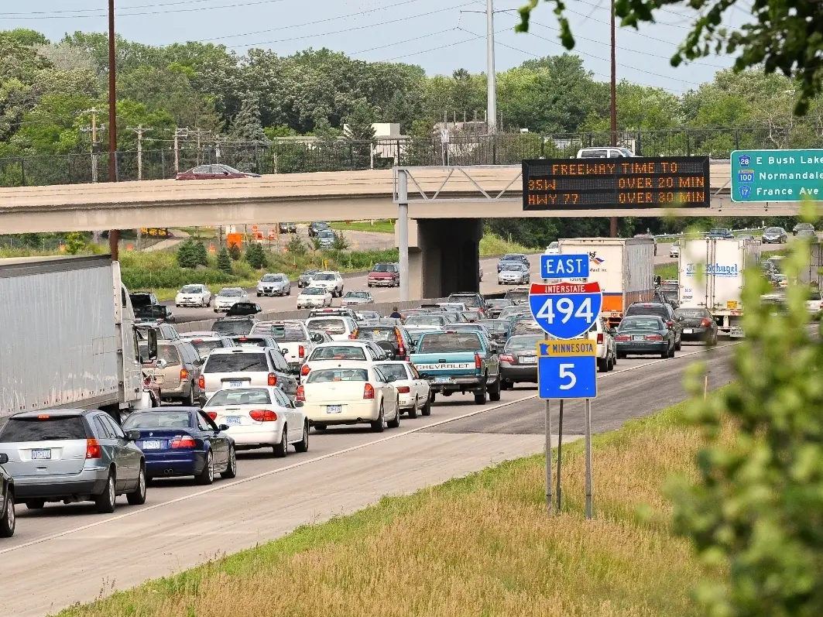
Traffic congestion continues to grow
… with no end in sight

Slide 3

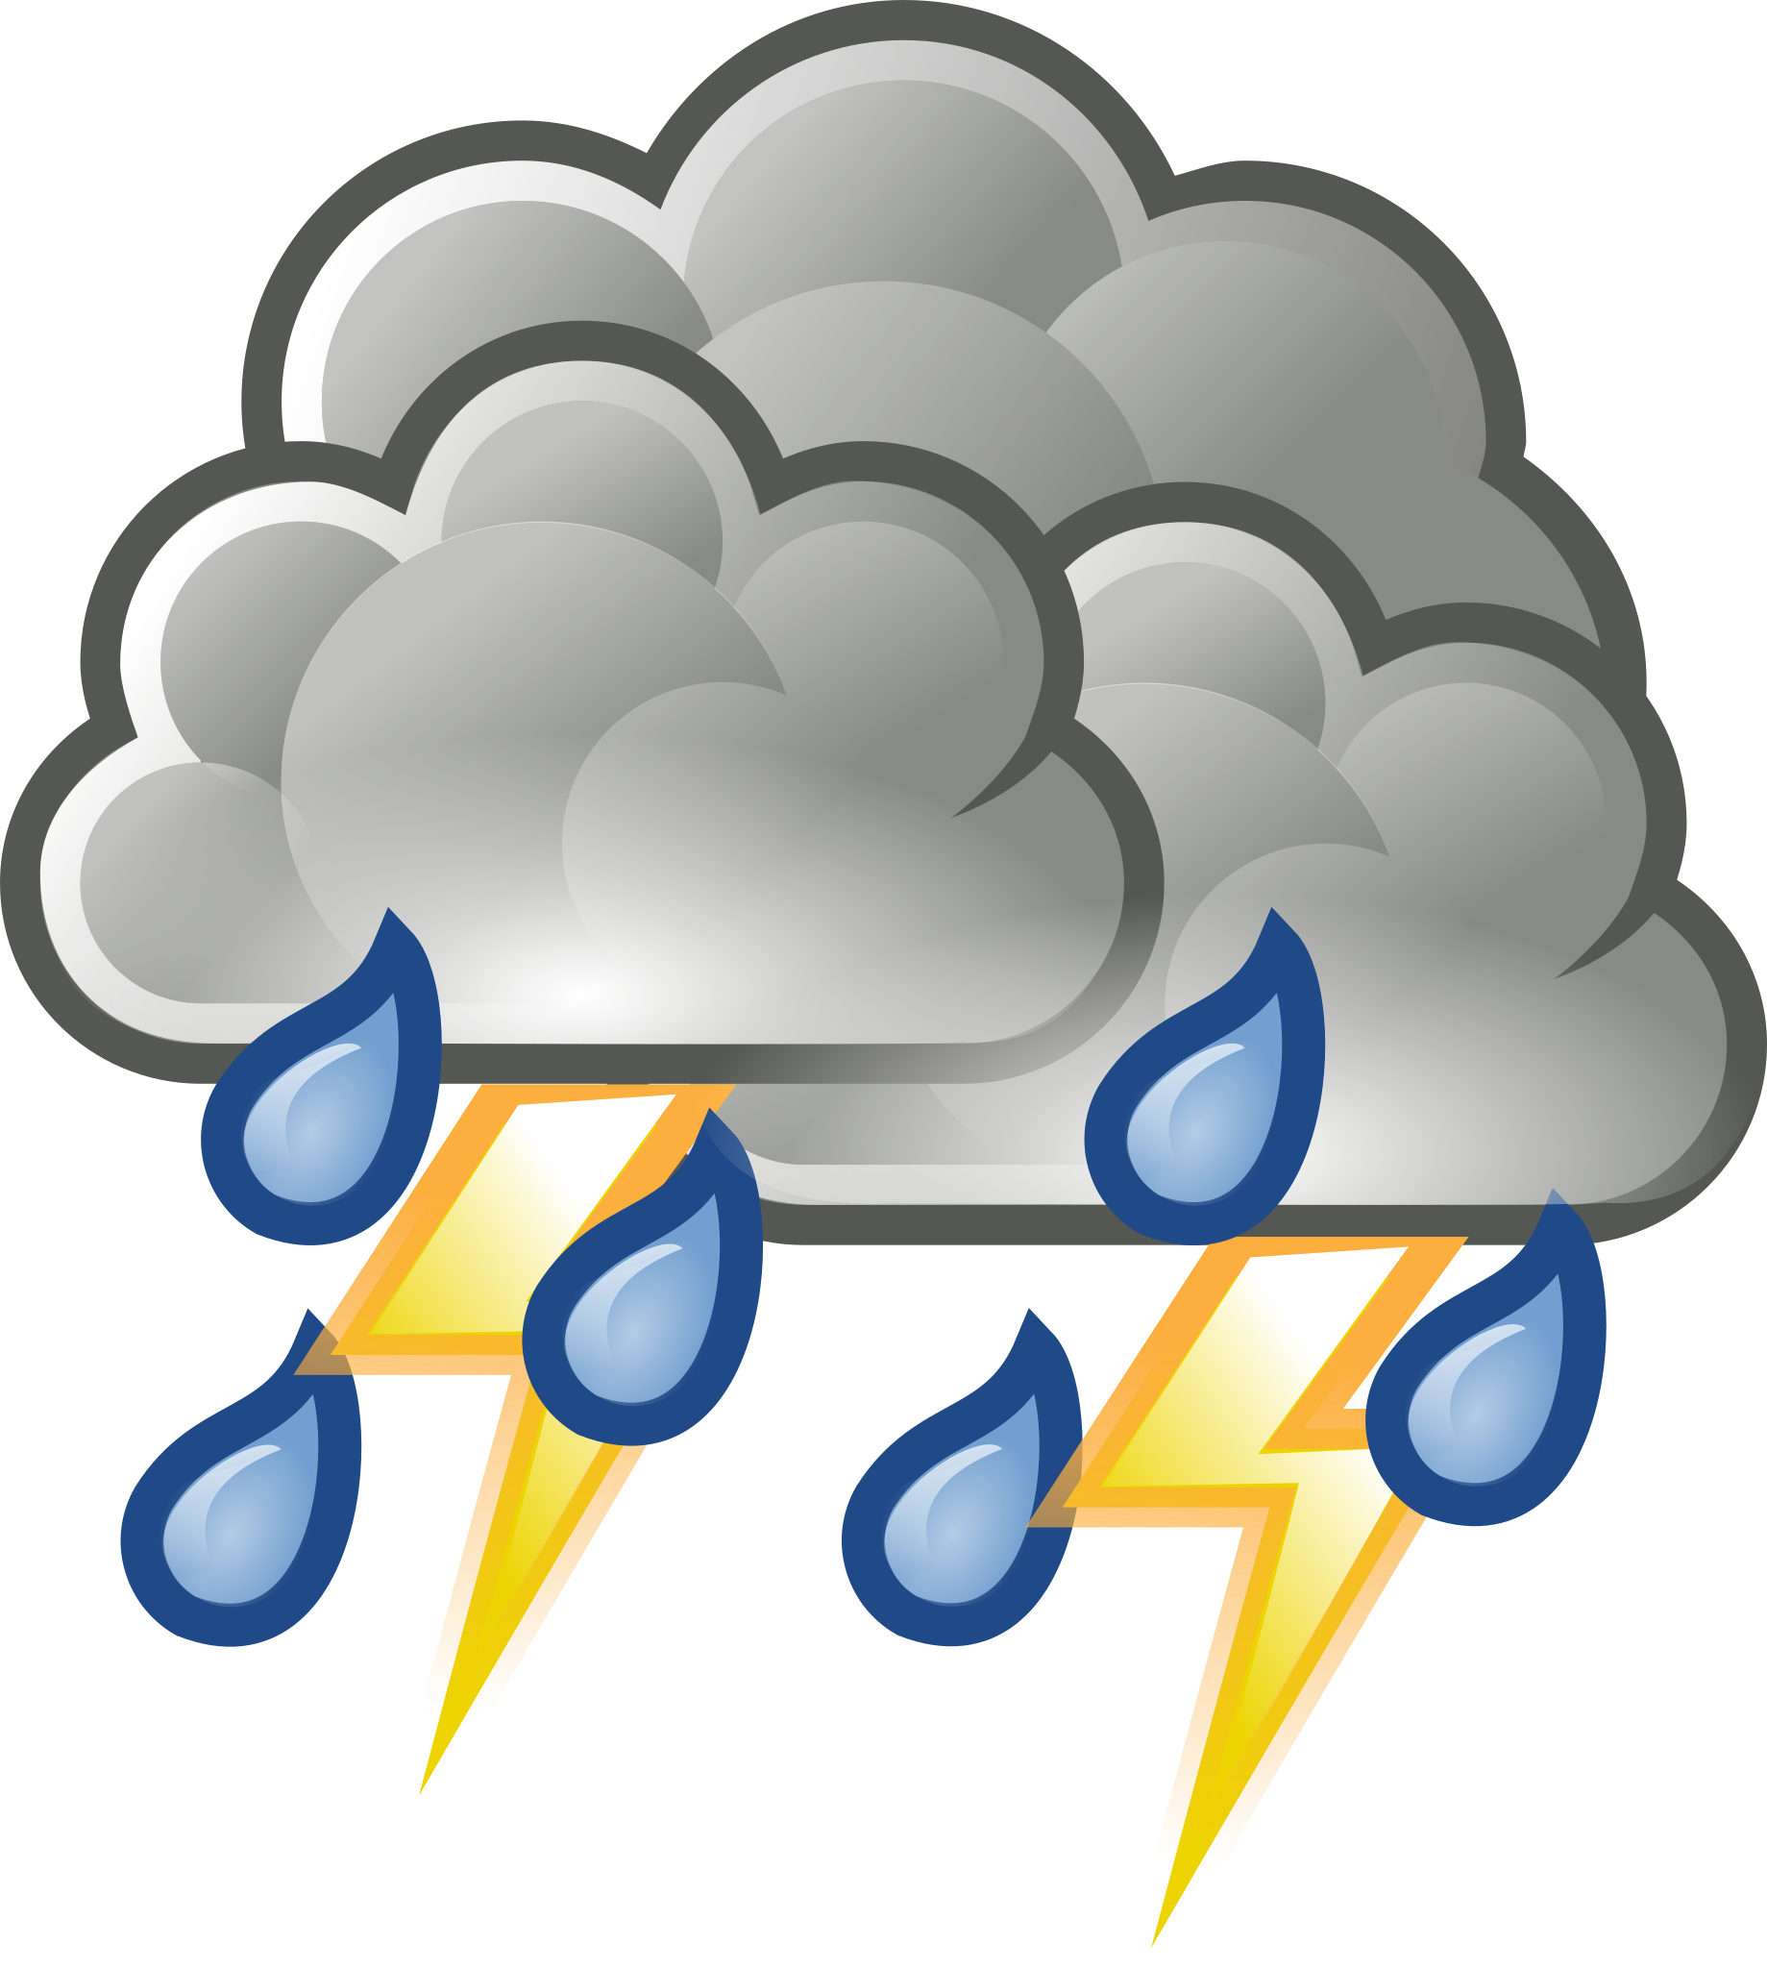
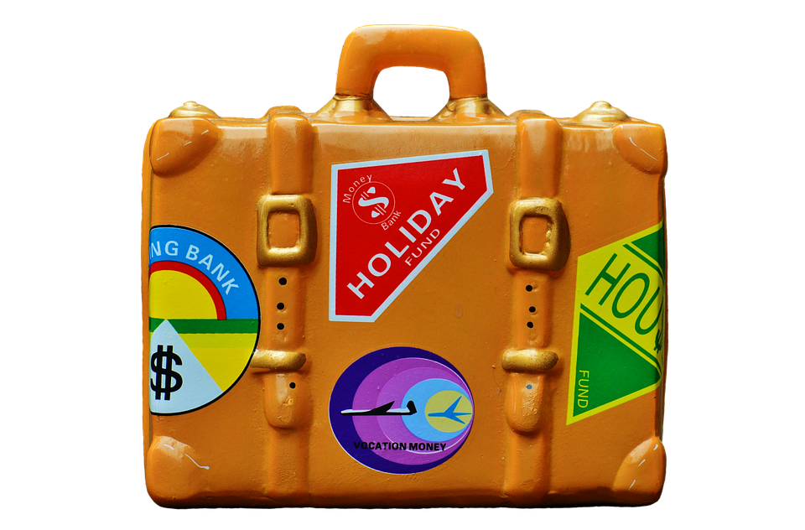
Analyzing the data in 3 distinct charts
Monthly Volumes
Viewing the monthly traffic patterns allows us to find any potential trends by month.
Weather
Weather can have an impact on many things, including traffic.
Holiday Travel
Our roads may see more travelers (including out of state) than expected.

Slide 4
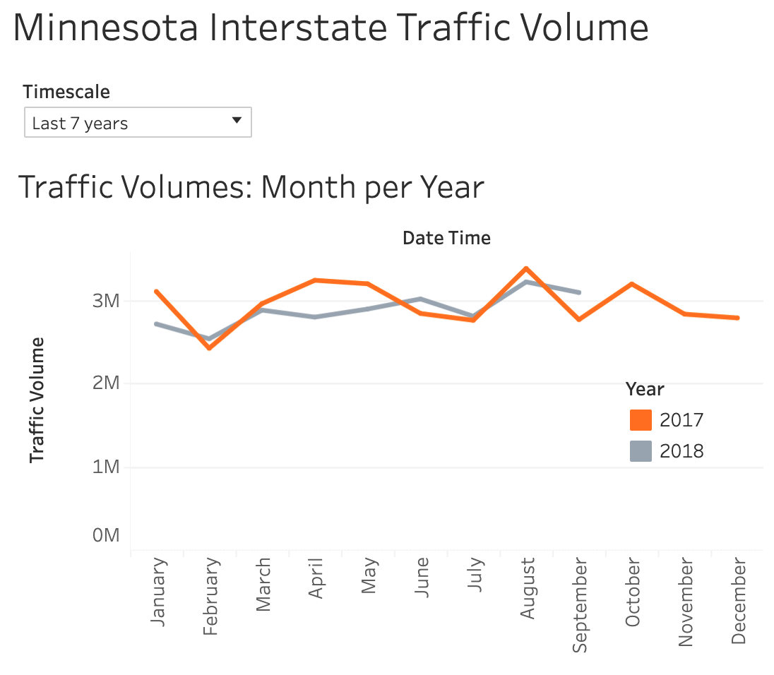
Monthly traffic volumes
August - Highest volume, possible end of summer seasonal traffic
February - Lowest volume, best possible month for construction changes
April - Significant decrease in 2018
Fairly consistent/predictable patterns

Slide 5
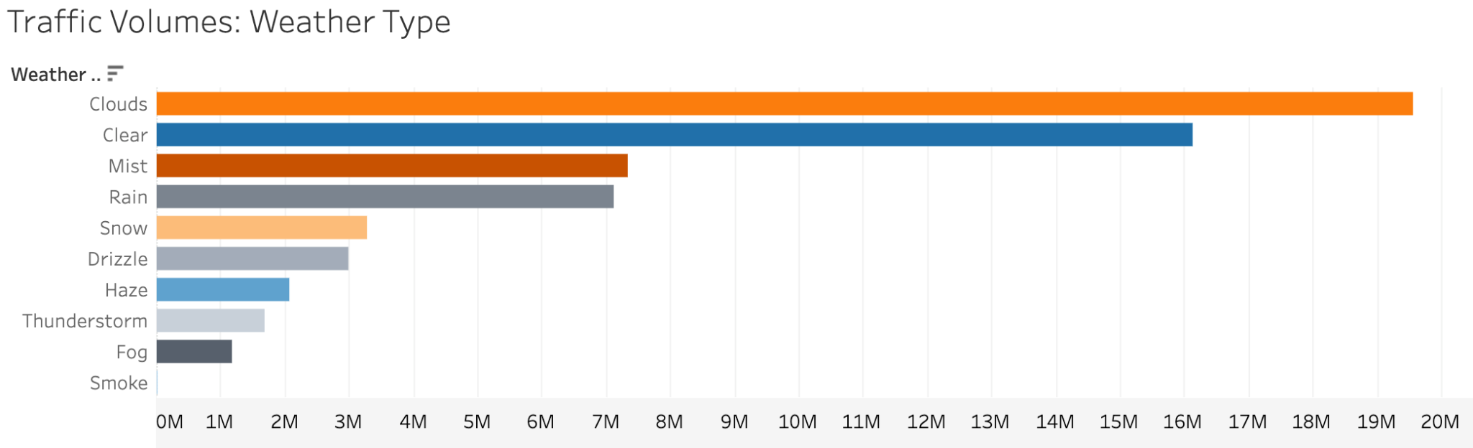
What role does weather play?
Clear/cloudy conditions result in the highest traffic volume.
Precipitation has a significant impact on traffic volume, though a surprising number of motorists continue to drive in rain.
Low-visibility conditions result in the lowest traffic volume.
What can we do to alleviate traffic issues on rainy days?

Slide 6
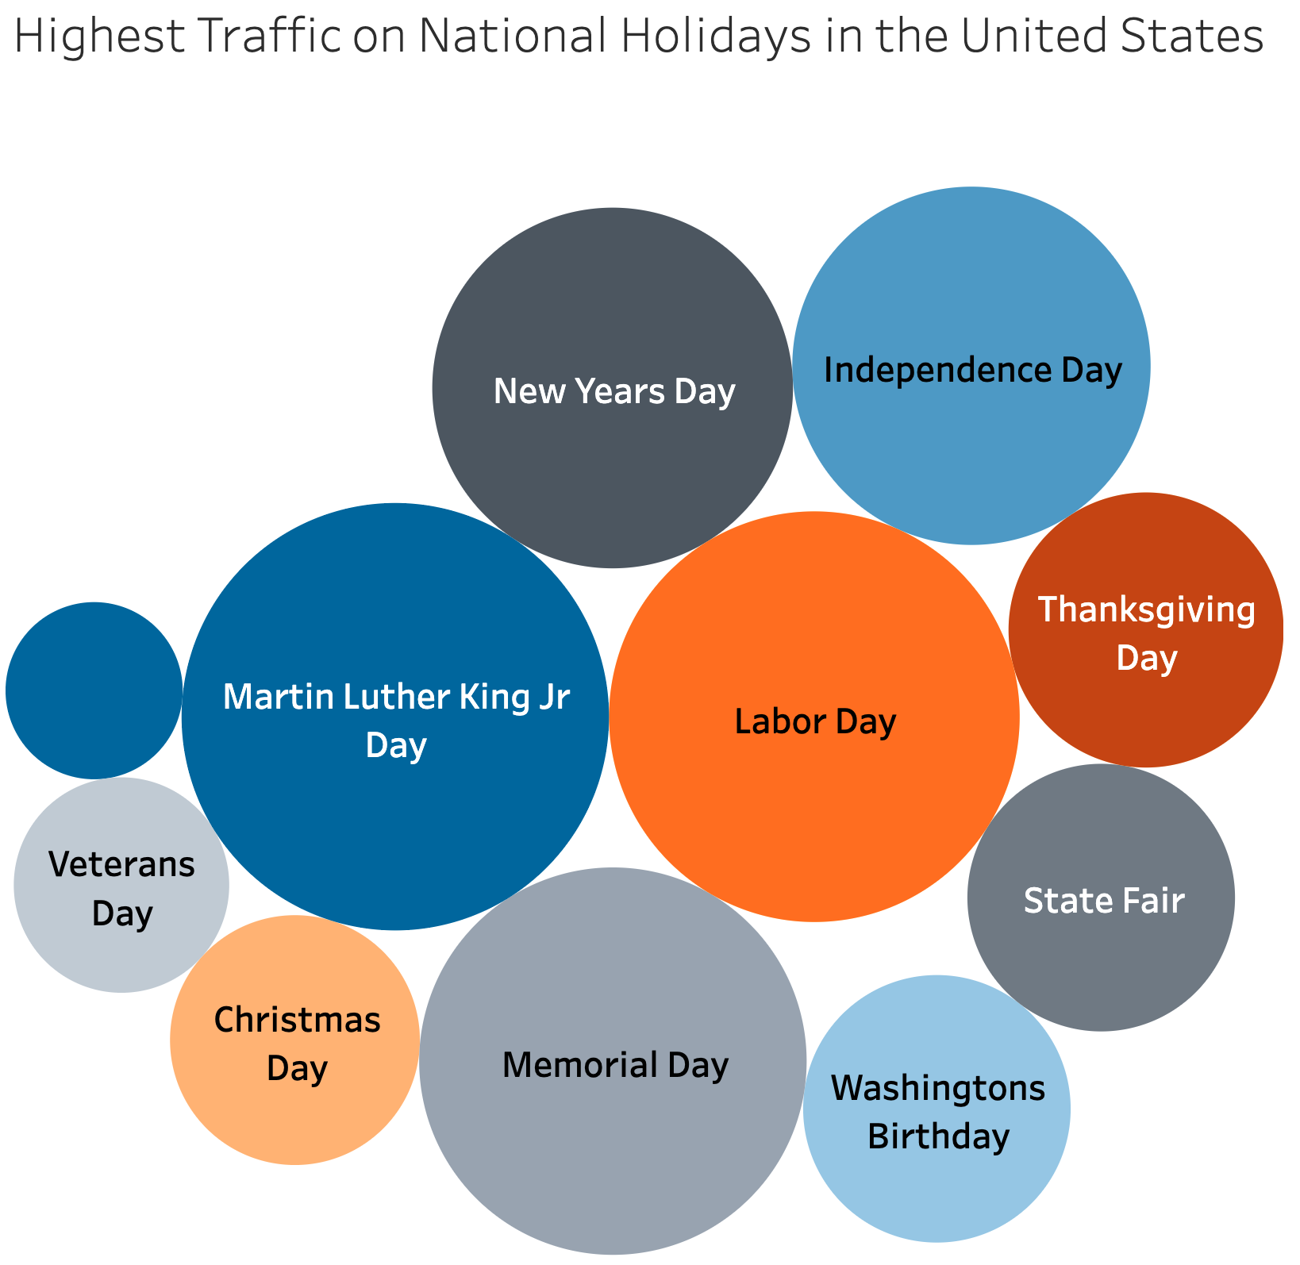
Holiday Travel
August - State fair starting in August
January - High traffic on New Years and Martin Luther King Jr. Day contribute to most of January’s total.
Most holidays have little impact on total traffic volume.

Slide 7
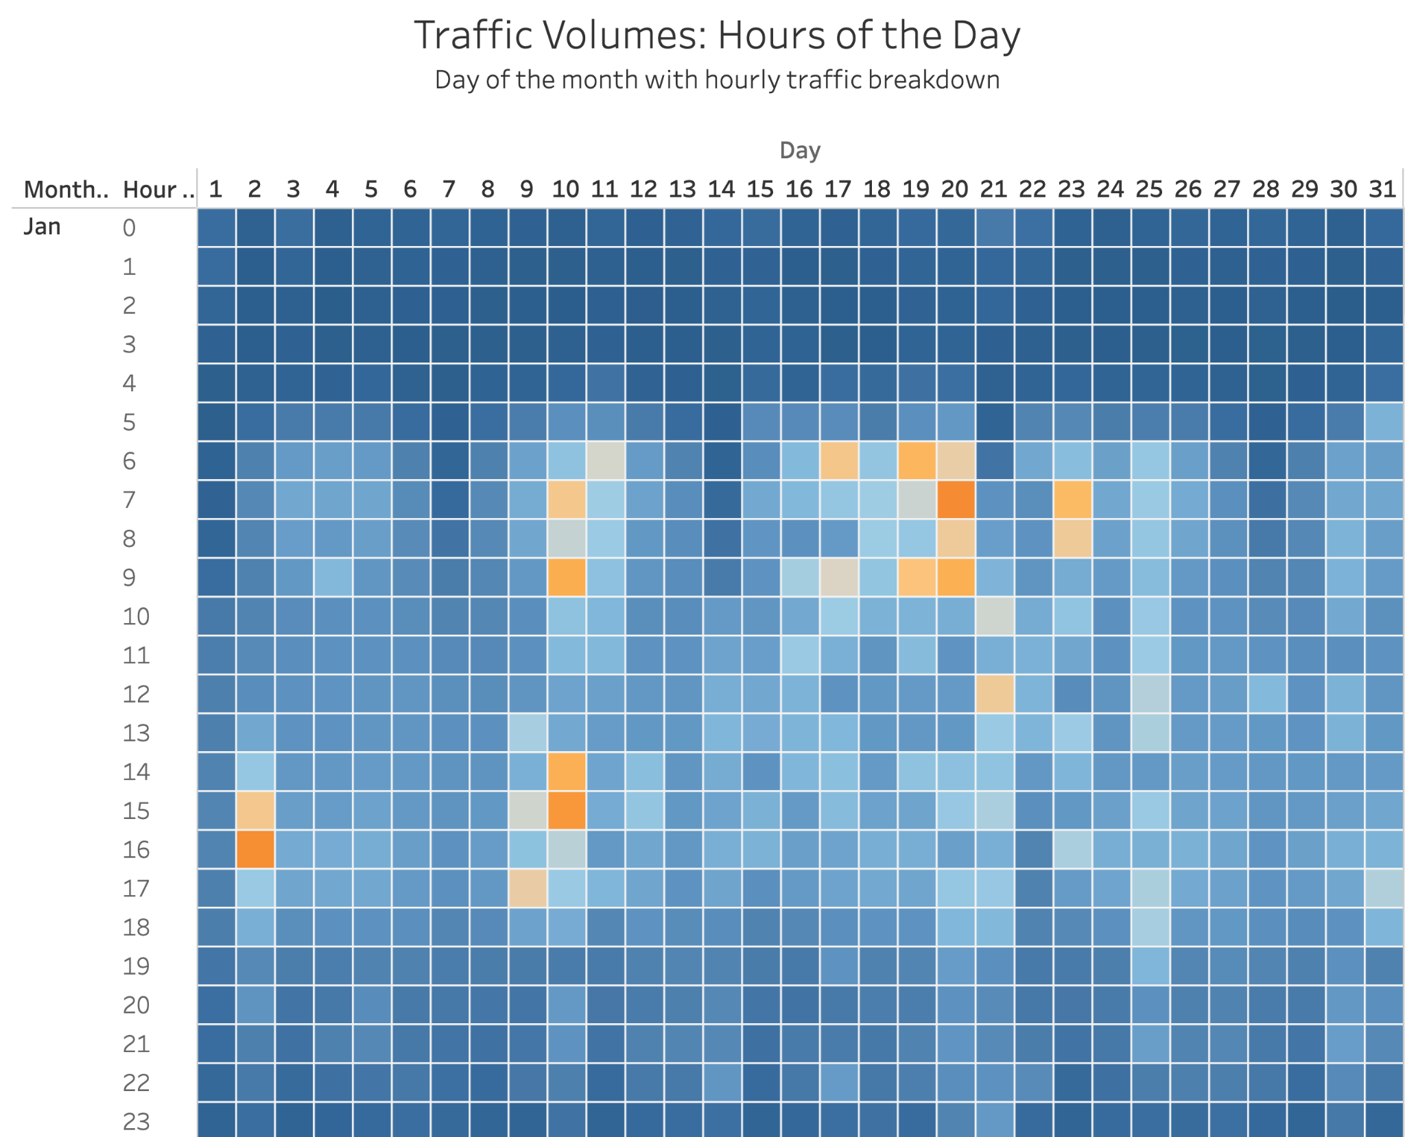
Hourly Traffic
Patterns are reflected during the busiest travel times: rush hours to and from work.
A day with a holiday does not have a significantly higher or lower traffic volume throughout the day.
Holidays do not impact hourly traffic volume.

Slide 8
Thank you!

